Slide 1
IoT Practice-I Firmware Programming of ATmega328

Slide 2
Objective
Understanding the basics of hardware structure and its operations of 8-bit microprocessor.
How to program the application software (firmware) executed on 8-bit microprocessor.

Slide 3
Training Kit
KT IoTMakers Starter Kit
Arduino UNO compatible
http://www.wowsystem.co.kr/index.php
Main board
Processor : ATmega328-AU,
https://kr.mouser.com/ProductDetail/Microchip-Technology-Atmel/ATMEGA328-AU?qs=lwdSMh1%2FoYJRHuGBjWz9Pg==
I/O board
Wi-Fi Shield
LED Module
FND Module
Ambient Light Sensor Module
Temperature Sensor Module
Ultrasonic Sensor Module
Motor Module

Slide 4
Practice Environment
Program development environment
Integrated Development Environment (IDE)
Atmel Studio 7 (atmel.com)
Arduino Software (Arduino.cc)
3rd-party tools, ….
Reference materials
ATmega328 Datasheet
AVR Instruction Set Manual

Slide 5
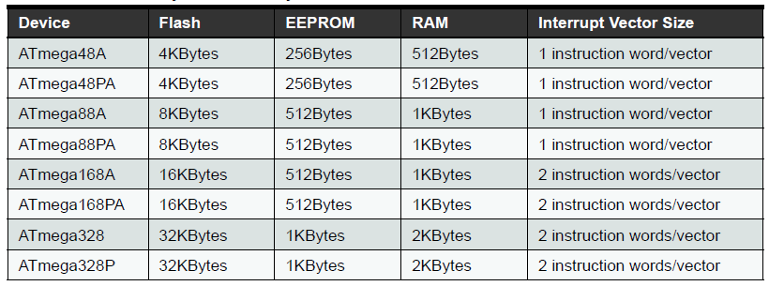
ATmega328 Processor
A low-power CMOS 8-bit microcontroller based on ARV RISC core
131 instructions : most single clock cycle execution
32 x 8 general purpose registers
~ 20MIPS @ 20MHz
On-chip 2-cycle multiplier
Memory : Flash/EEPROM/RAM
Write/Erase cycles : 10K Flash/100K EEPROM

Slide 6
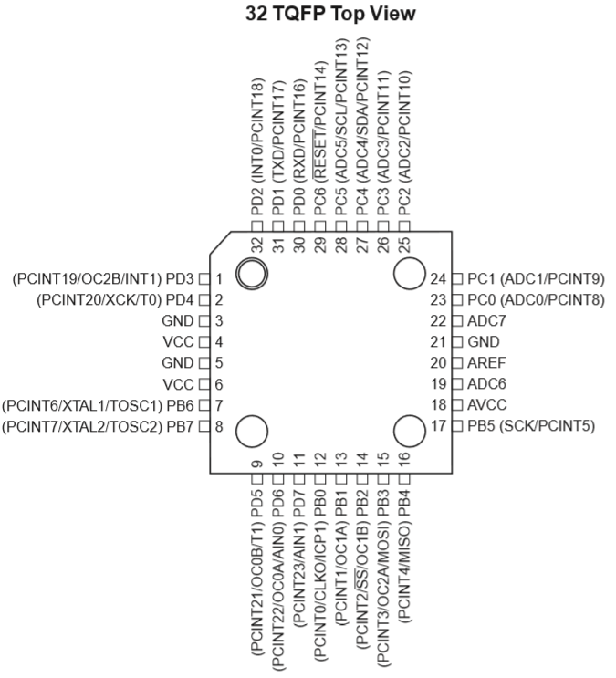
ATmega328 Processor
Peripherals
23 I/O lines
2 x 8-bit timer/counter
1 x 16-bit timer/counter
RTC
6 PWM channels
8-ch 10-bit ADC in TQFP/MLF/QFN package
6-ch 10-bit ADC in PDIP package
1 UART
1 SPI
1 I2C
Watchdog timer
Analog comparator
Operating condition
Power supply : 1.8~5.5V
Temperature : -40~85 degree
Speed grade : 0~4MHz@1.8~5.5V, 0~10MHz@2.7~5.5V, 0~20MHz@4.5~5.5V
Power consumption : 0.2mA@active, 0.1uA@power-down, 0.75uA@power-save

Slide 7
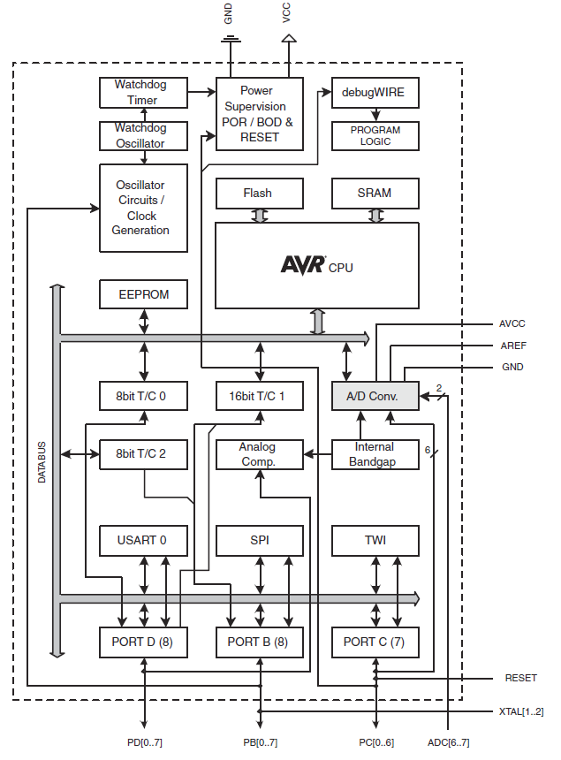
ATmega328 Processor
Block diagram of ATmega328

Slide 8
AVR Core

Slide 9
Overview of AVR Core
AVR Core
CPU core of ATmel processor
8-bit RISC micro-controller
A modified Harvard architecture : separate I/D memory.
History of AVR
In 1996, 2 students(Alf-Egil Bogen, Vegard Wollan) in Norweign Institute of Technology (NTH) originally designed a uRISC processor.
In 2016.1, Microchip acquired ATmel for $3.56 billion.
Microchip provides PIC & AVR processor.
Line-up of AVR processors
https://www.microchip.com/design-centers/8-bit

Slide 10
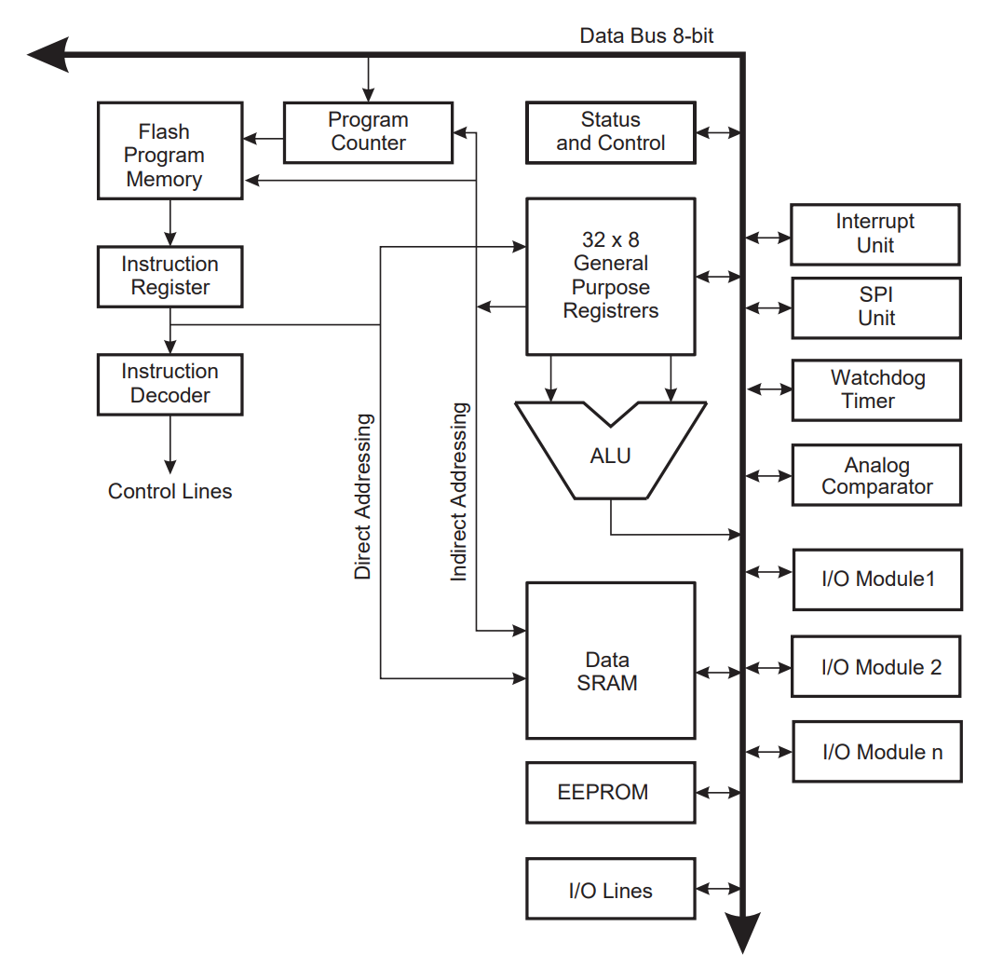
Block Diagram of AVR Core
Registers
Program
Memory
I/O
Control
Unit
Data
Memory

Slide 11
Pipelining of AVR Core
2-stage pipeline
1 instruction cycle consists of 2 operation cycles.
2 operation cycles are overlapped.
During one instruction is executed, the next one is pre-fetched from program memory.
Instruction pre-fetch
Instruction Cycle
Sequential Execution of a series of Instructions
I-Fetch
I-Execute
I-Fetch
I-Execute
I-Fetch
I-Execute
I-Fetch
I-Execute
Operation Cycle
2-Stage Pipelining
I-Fetch
I-Execute
I-Fetch
I-Execute
I-Fetch
I-Execute
Pipeline
Latency
Concurrent Execution

Slide 12
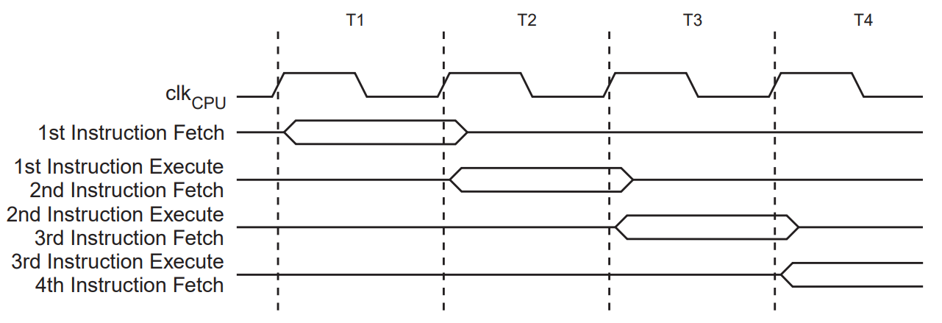
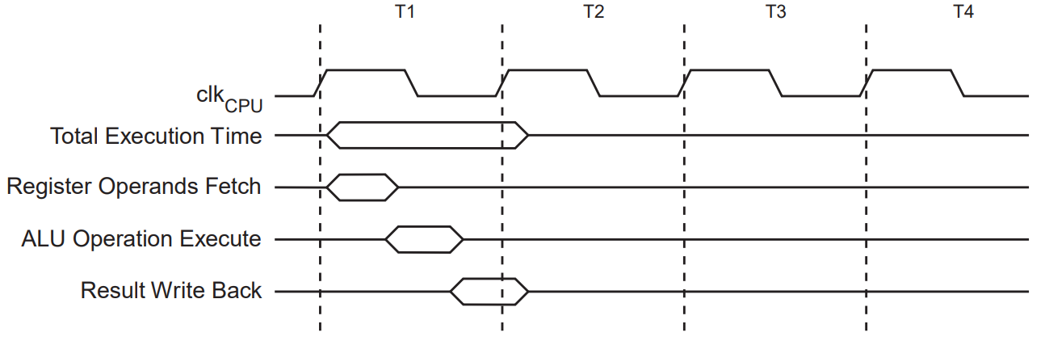
Instruction Execution Timing
Parallel instruction fetches & instruction executions
Single cycle ALU operation

Slide 13
Memory Structure of AVR Core
Harvard Architecture
Separate program memory & data memory
Separated access bus.
Parallel memory access is possible, so good for pipelining.
Von Neumann Structure
Harvard Structure
CPU
Program
Memory
Data
Memory
CPU
Program
Memory
Data
Memory
Simultaneous code & data access is not possible.
Parallel code & data access is possible.

Slide 14
Registers of AVR Core
General Purpose Register (GPR)
Status Register (SREG)
Stack Pointer (SP)
Address Pointer Register (X-, Y-, Z-Register)

Slide 15
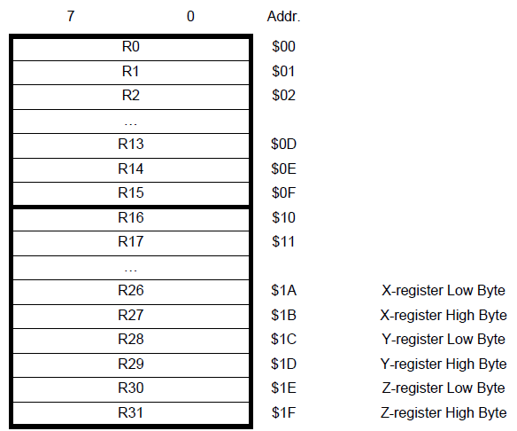
General Purpose Register (GPR)
32 x 8-bit register
R0~R31
R26~R31 are used as address pointer registers.
32 GPR’s are mapped into data memory space(0x00 ~ 0x1F).
Memory access instruction can access to GPR’s.

Slide 16
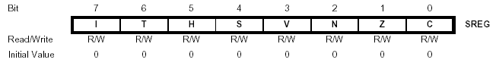
Status Register (SREG)
Contains information about the result of the most recently executed arithmetic instruction.
Used for altering program flow in order to perform conditional operations
SREG is also mapped to data memory(0x5F).
Bit configuration of SREG
I : Global interrupt enable, 1 = enabled
S : Sign bit, S = N XOR V
V : 2’s complement overflow flag
N : Negative flag, Z : zero flag, C : carry flag
H : Half carry flag
T : Temporal storage for bit copy instruction(BLD, BST)

Slide 17
Stack
Stack
Data memory space specially reserved for
storing temporal data, passing parameters, local variables, return address, used-registers-saving when function call, interrupt request are processed.
Special instructions are used to handle stack : PUSH, POP
Types of stack
Ascending/Descending
Full/Empty
hardware stack : stack in registers
high
PUSH
POP
SP
low

Slide 18
Stack Pointer (SP)
Point to the top of stack
Stack pointer in AVR core
16-bit stack pointer
2 x 8-bit registers (SPH, SPL) are connected to make 16-bit stack pointer.
SPH, SPL : I/O space of data memory at 0x5D, 0x5E.
When processor is reset, SP is automatically set to ‘0’.
Before interrupt or function call is issued, SP should set to be over 0x60.
GPR & I/O space of data memory : 0x00~0x60.
Stack operations
PUSH : write data to stack, SP is decreased.
POP : read data from stack, SP is increased.

Slide 19
Address Pointer Register
AVR core has 3 address pointer registers(X, Y, Z)
16-bit pointer
2 x 8-bit GPR’s are connected.
To access data memory indirectly, 16-bit address pointer register is used.
X-Register
R26(low-byte), R27(high-byte)
Y-Register
R28(low-byte), R29(high-byte)
Z-Register
R30(low-byte), R31(high-byte)
Used when a constant stored in program memory is accessed using LPM, ELPM, SPM instructions.

Slide 20
On-chip Memory of AVR Core
Program memory
Flash memory to store program code.
Non-volatile
Mostly read-only.
Data memory
SRAM
Temporal storage for data(variable, constant) used during program execution.
Volatile
Read & Write
EEPROM
Permanent storage for data
Non-volatile
Mostly read-only.

Slide 21
Program Memory
Configuration of flash memory
32K/64K/128K x 2-bytes 구성
Instruction length : 2-bytes, 4-bytes
Program counter : 15/16/17-bit
Support to store data in program memory for the use of constant & lookup table.
How to write binary code(executable) to flash memory (fusing)
SPI, JTAG interface.
Duration : 10,000 write/erase cycles

Slide 22
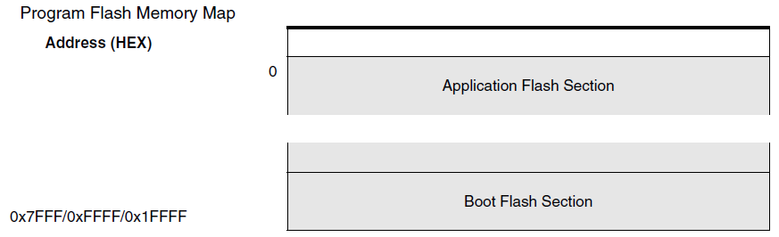
Program Memory
Program memory is divided into 2 sections.
Boot program section
Store boot program or the program supporting self-programming function.
Application program section
Store application program.
The size of each section is adjustable (configurable).
Lock bit is used to protect any unwanted write to each section.

Slide 23
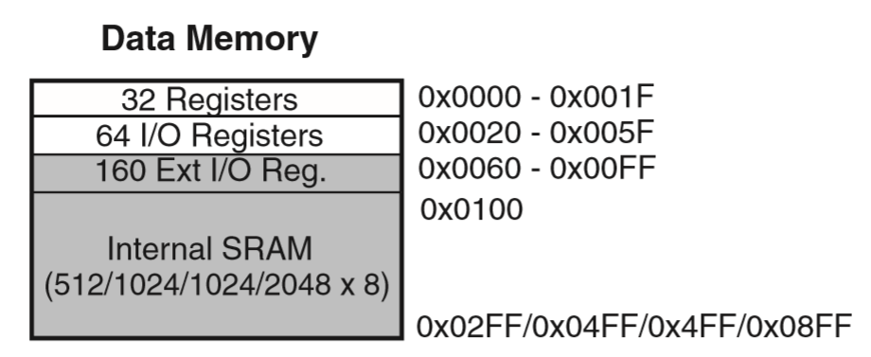
Data Memory
SRAM data memory
Unified data memory map
GPR, I/O registers, internal data SRAM are mapped to an unified memory space.
Addressing modes
Direct, Indirect, Indirect with displacement, Indirect with pre-decrement, Indirect with post-increment.
How to access to I/O space
Same as data memory access : LD/LDS/LDD, ST/STS/STD instructions.
Access as a separate I/O space : IN/OUT instructions.

Slide 24
I/O Space
I/O Registers within the address range 0x00 - 0x1F are directly bit-accessible using the SBI and CBI instructions.
Special Function Registers (SFR)
SREG : $5F
SP : SPH ($5E), SPL ($5D)

Slide 25
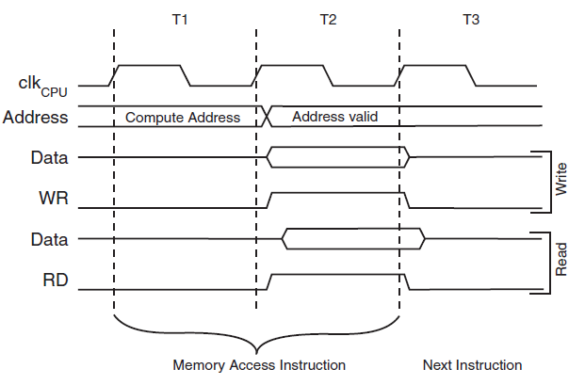
Data Memory
Memory Access : 2 cycles

Slide 26
Data Memory (EEPROM)
On-chip EEPROM
Permanent data storage. Non-volatile
Separate memory space.
Duration
100,000 write/erase cycle.
EEPROM access registers
used for EEPROM access.
EEPROM address register : EEARH, EEARL
EEPROM data register : EEDR
EEPROM control register : EECR
CPU halt
When the EEPROM is read, the CPU is halted for four clock cycles before the next instruction is executed.
When the EEPROM is written, the CPU is halted for two clock cycles before the next instruction is executed.
Notes:
AVR 코어에는 4 KB 크기의 EEPROM 메모리가 내장되어 있다. 이 메모리는 비휘발성 (non-volatile) 메모리이기 때문에 전원공급이 중단된 경우에도 저장된 데이터를 유지할 수 있기 때문에 데이터 보관용으로 사용될 수 있다. 즉, 일반 컴퓨터의 하드 디스크 역할을 한다. SRAM 은 전원공급이 중단되면 데이터가 사라지기 때문에 데이터 보관이 필요한 경우, EEPROM 으로 저장하여 보관하고 다시 사용할 경우에는 EEPROM 에서 직접 읽어서 사용하거나, SRAM 으로 복사한 후 사용할 수 있다. EEPROM 에서 직접 읽는 경우는 시간이 많이 걸리기 때문에, SRAM 으로 복사한 후 사용하는 것이 프로그램의 실행속도 향상에 좋다.
EEPROM 은 디바이스 특성상 읽고 쓰는 횟수에 제한이 있다. AVR 코어에는 10 만번 정도를 읽고 쓸 수 있는 EEPROM 을 내장하고 있다.
EEPROM 은 데이터 메모리 공간과 별도의 어드레스 공간을 가지고 있다. 따라서, 별도의 메모리 인터페이스를 사용하기 위하여 전용 레지스터를 사용한다. 메모리를 사용하기 위해서는 어드레스, 데이터, 컨트롤 신호가 필요하기 때문에 EEPROM 메모리를 액세스하기 위한 전용 어드레스 레지스터 (EEAR : EEPROM Address Register), 데이터 레지스터(EEDR : EEPROM Data Register), 컨트롤 레지스터 (EECR : EEPROM Control Register) 를 가지고 있다.
4KB 크기의 EEPROM 공간을 사용하기 위해서는 12-비트 어드레스가 필요하다. 따라서, 8-비트 레지스터 2개를 연결해서 사용한다. 즉, 12-비트 어드레스의 상위 바이트를 저장하는 EEARH 와 하위 바이트를 저장하는 EEARL 2 개를 연결해서 사용한다.
EEPROM 을 읽거나 쓰는 시간이 CPU 클럭 싸이클 시간보다 길기 때문에 CPU 는 EEPROM 액세스가 완료될 때까지 기다려야 한다. EEPROM 을 읽을 경우에는 4 클럭 싸이클, 쓸 때에는 2 클럭 싸이클 동안 CPU 가 동작을 중지한다.

Slide 27
I/O’s of ATmega328

Slide 28
On-chip I/O’s
GPIO (General purpose I/O)
23 x Programmable I/O’s
8-bit port :B, D
7-bit port : C
Timer
2 x 8-bit timer (Timer-0/Timer-2)
1 x 16-bit timer (Timer-1)
1 x RTC(realtime clock) with separate osclliator
1 x Watchdog timer : programmable
PWM (Pulse Width Modulation)
6 x PWM channels

Slide 29
On-chip I/O’s
Analog interface
8-ch 10-bit ADC in TQFP/MLF/QFN package
6-ch 10-bit ADC in PDIP package
Analog comparator
Communication interface
1 x UART
1 x SPI
1 x I2C

Slide 30
GPIO

Slide 31
GPIO
General Purpose I/O
Multi-purpose digital input/output pin
Voltage level : TTL-level
If logical ‘1’ is out to GPIO, the voltage level corresponding to logical value ‘1’ (ex, 5V) is sustained.
ATmega328의 GPIO
23 pins are available for GPIO.
8-bit port :B, D
7-bit port : C
Alternate function

Slide 32
GPIO Control Registers
GPIO control registers control the operations of GPIO.
Data direction register (DDR)
Control the flow direction of GPIO. R/W
‘0’ as input, ‘1’ as output
Read/Writable
Input Pins Address (PIN)
Store the input value of GPIO pin.
Read/Writable
Data register (PORT)
Output register.
Read/Writable
If you want to send data to GPIO, just write data value to PORT register. If you get data from GPIO, read PIN register.

Slide 33
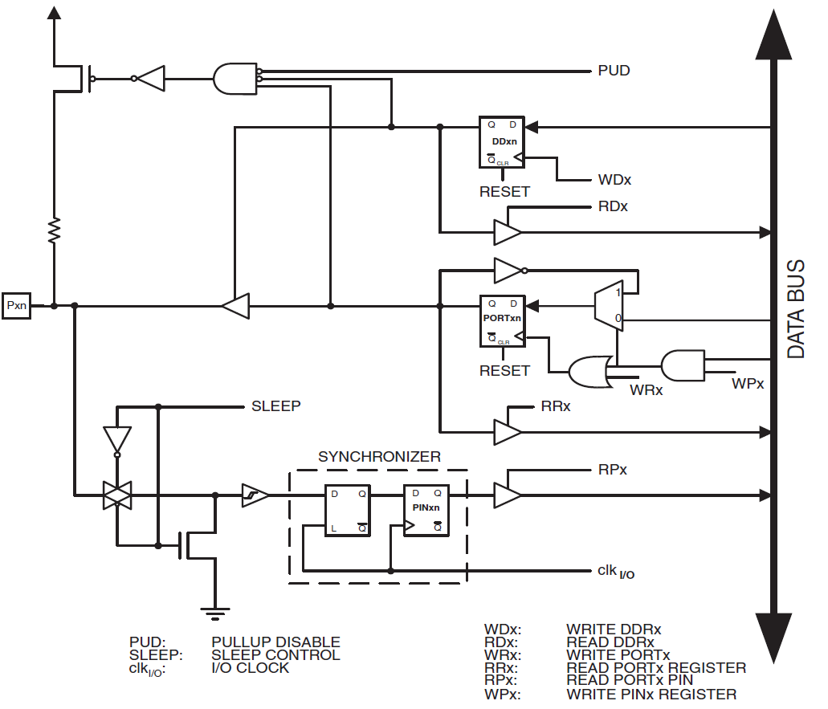
Block Diagram of GPIO
Data Direction Register (DDR)
Data Register (PORT)
Port Input Pin (PIN)

Slide 34
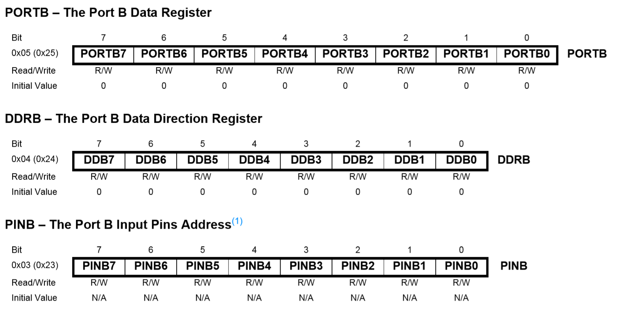
GPIO Control of Port B

Slide 35
GPIO Control
GPIO control register map of AVR series
Port | DDR | PORT | PIN
A | 0x21 | 0x22 | 0x20
B | 0x24 | 0x25 | 0x23
C | 0x27 | 0x28 | 0x26
D | 0x2A | 0x2B | 0x29
E | 0x2D | 0x2E | 0x2C
F | 0x30 | 0x31 | 0x2F
G | 0x33
H | 0x101 | 0x102 | 0x100
J | 0x104 | 0x105 | 0x103
K
L

Slide 36
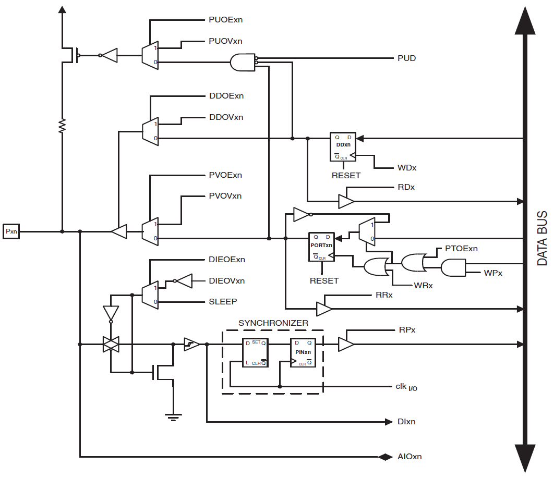
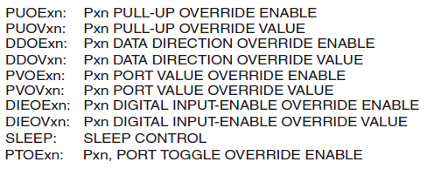
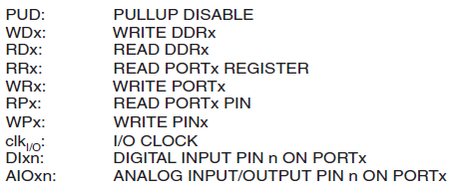
Alternate Function 사용

Slide 37
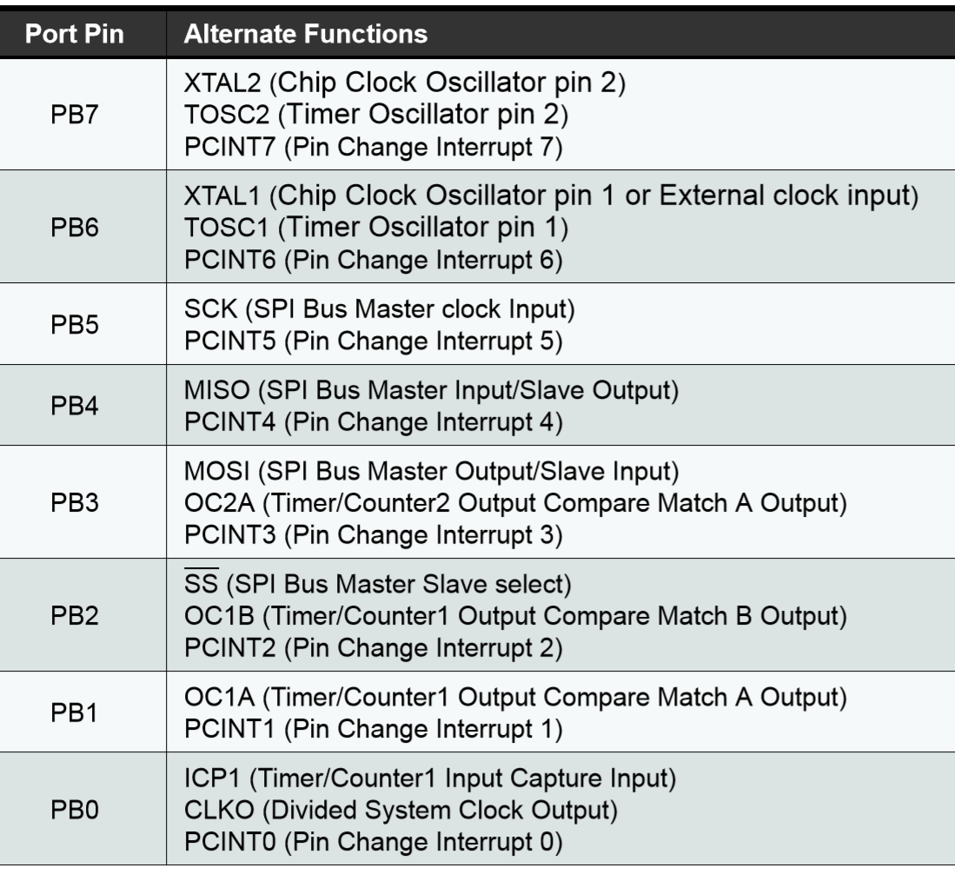
Alternate Port Function
Port-B

Slide 38
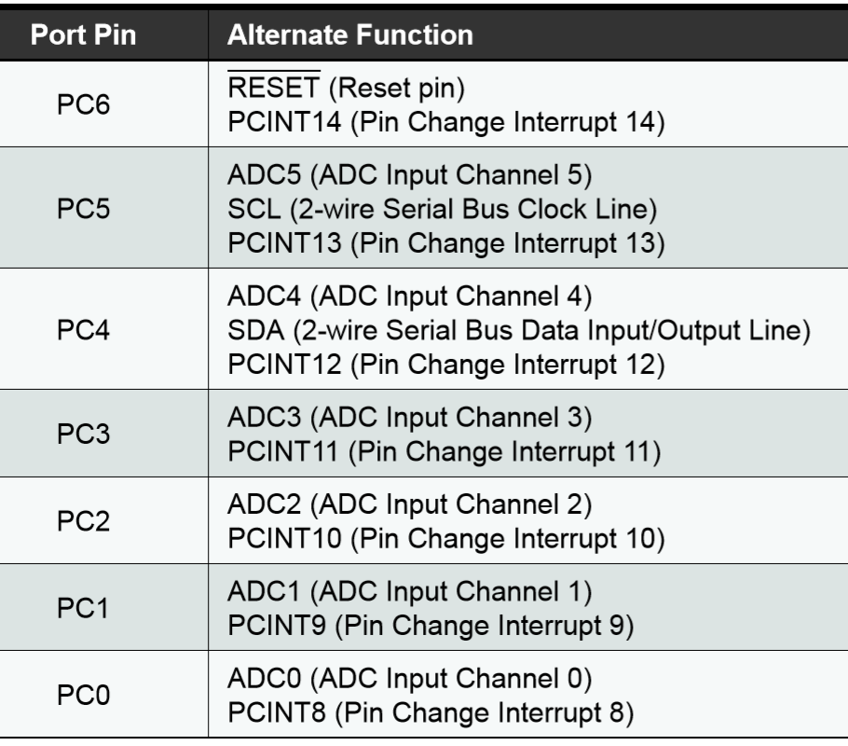
Alternate Port Function
Port-C

Slide 39
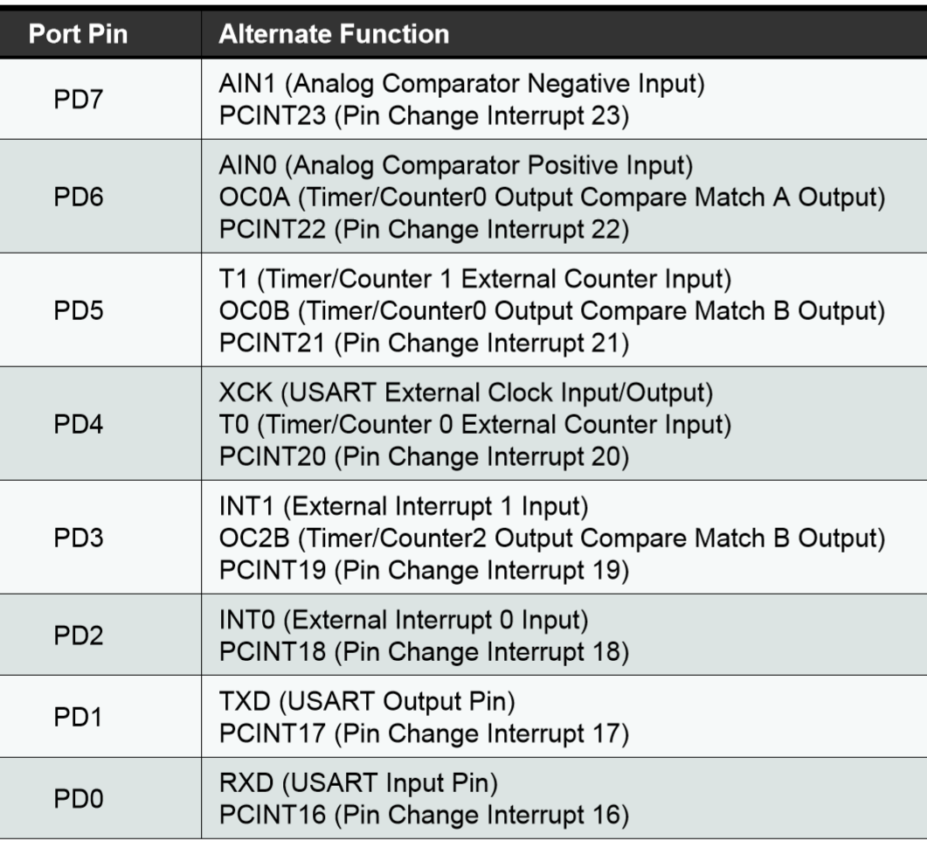
Alternate Port Function
Port-D

Slide 40
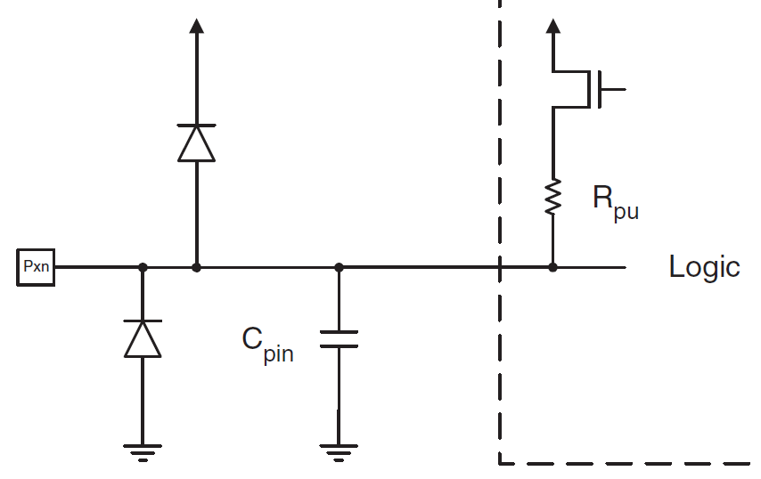
GPIO Pull-up Resistor
To protect an input pin in float state, a pull-up/down resistor is used.
GPIO in AVR, has an internal pull-up register (min.=20, max.=50Kohm)
input mode에서 사용
After setting GPIO to input mode, writing ‘1’ to GPIO will internally connect pull-up resistor to input pin.
If pull-up resistor is not necessary, writing ‘0’ to GPIO or changing its pin mode to output is required.
To disable all pull-up resistors of all GPIO’s, set PUD bit(flag) of MCUCR to ‘1’.
pull-up resistor

Slide 41
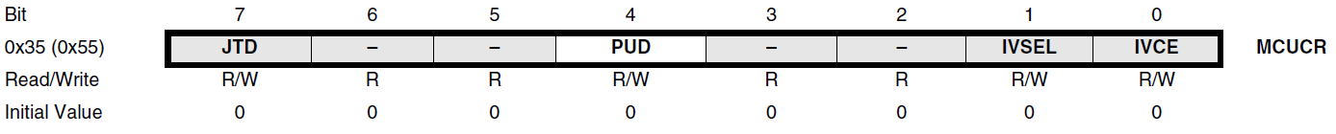
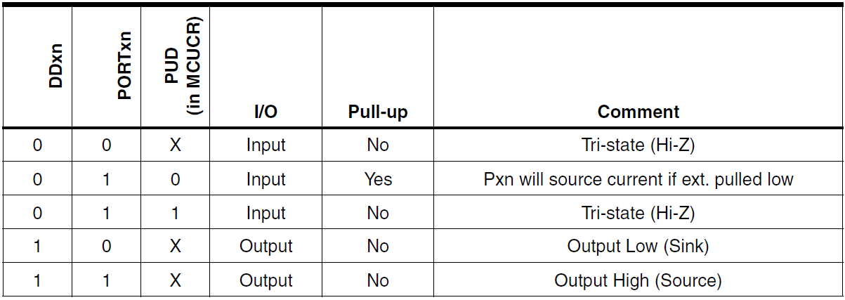
GPIO Pull-up Resistor
Internal pull-up register

Slide 42
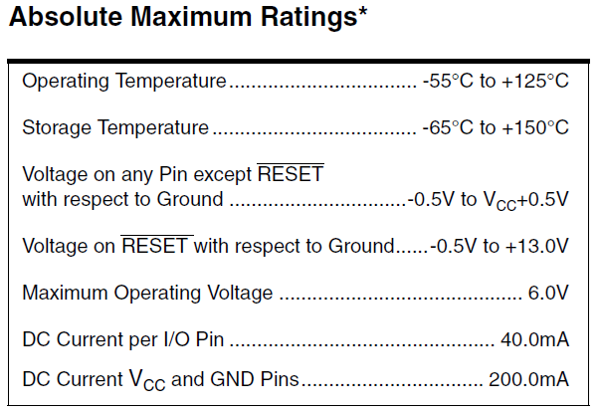
Electrical Characteristics of GPIO

Slide 43
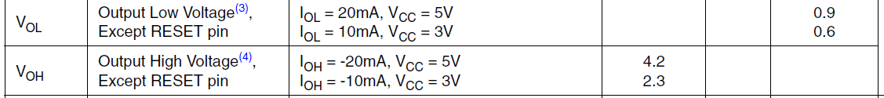
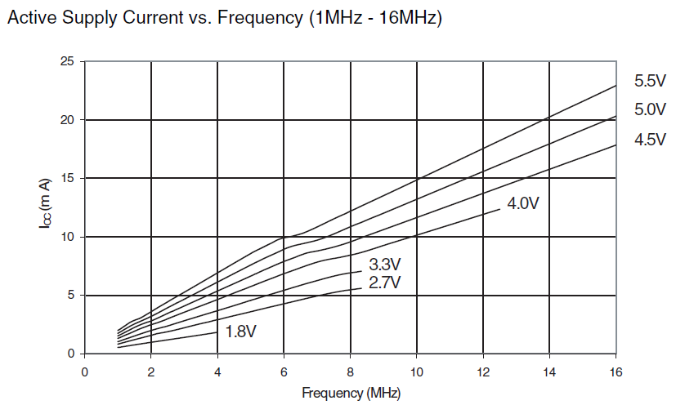
Electrical Characteristics

Slide 44
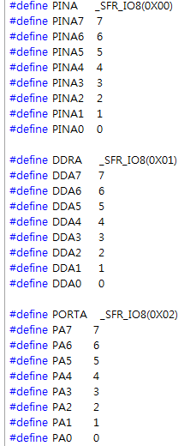
GPIO Pin Macro
header file : ~Arduino/hardware/tools/avr/avr/include/avr/iomxx0_1.h
#include<avr/io.h>
#include<util/delay.h>
int main(){
char i;
unsigned char LED_Data = 0x00;
DDRE = 0xFF; // Port E = output
while(1){
PORTE = LED_Data;
LED_Data++;
for(i=0;i<10;i++)
_delay_ms(100);
}
return 0;
}
pinMode()
digitalWrite()
#include<avr/io.h>
int main(){
DDRE = 0xFF; // Port E = output
DDRB = 0x00; // Port B = input
while(1){
PORTE = PINB; // push & display
}
return 0;
}
pinMode()
digitalWrite()
digitalRead()

Slide 45
Interrupt

Slide 46
Overview of Interrupt
Polling vs. Interrupt ???
A good way to interact between I/O device and CPU.
CPU request a task to I/O device.
After I/O device finished the task given by CPU, it activates interrupt request signal to acknowledge its finish to CPU.
Interrupt source
Internal interrupt : interrupt generated by abnormal situation during program execution.
Trap : divided by zero, memory access violation
Software interrupt : execution of SWI instruction.
External interrupt : hardware interrupt generated by internal/external I/O device.

Slide 47
Overview of Interrupt
Interrupt mask
A bit which controls whether an interrupt can be processed(enabled) or not(disabled).
NMI (Non-Maskable Interrupt) : reset
Global mask : applied to all interrupts
Local mask : applied to a specific interrupt.
Interrupt detection
Polled interrupt checking : periodical check the interrupt request(flag).
Vectored Interrupt checking : if interrupt is requested, the flow of program execution branches automatically to a specific address of program memory.
Interrupt Service Routine (ISR)
Interrupt handling function.
Interrupt handler.

Slide 48
Overview of Interrupt
Interrupt vector
A pre-defined address to which the flow of program execution branches whenever interrupt is requested.
The start address of ISR
Interrupt vector table(IVT)
A table of interrupt vectors (pointers to ISR)
The table that specifies the addresses of all interrupt handlers.
Interrupt Priority
Urgency level of each interrupt.
In general, Lower priority means higher urgency.
Used to decide the order of interrupt handling when multiple interrupts are requested at the same time, or new interrupt is requested during the previous interrupt is handled.

Slide 49
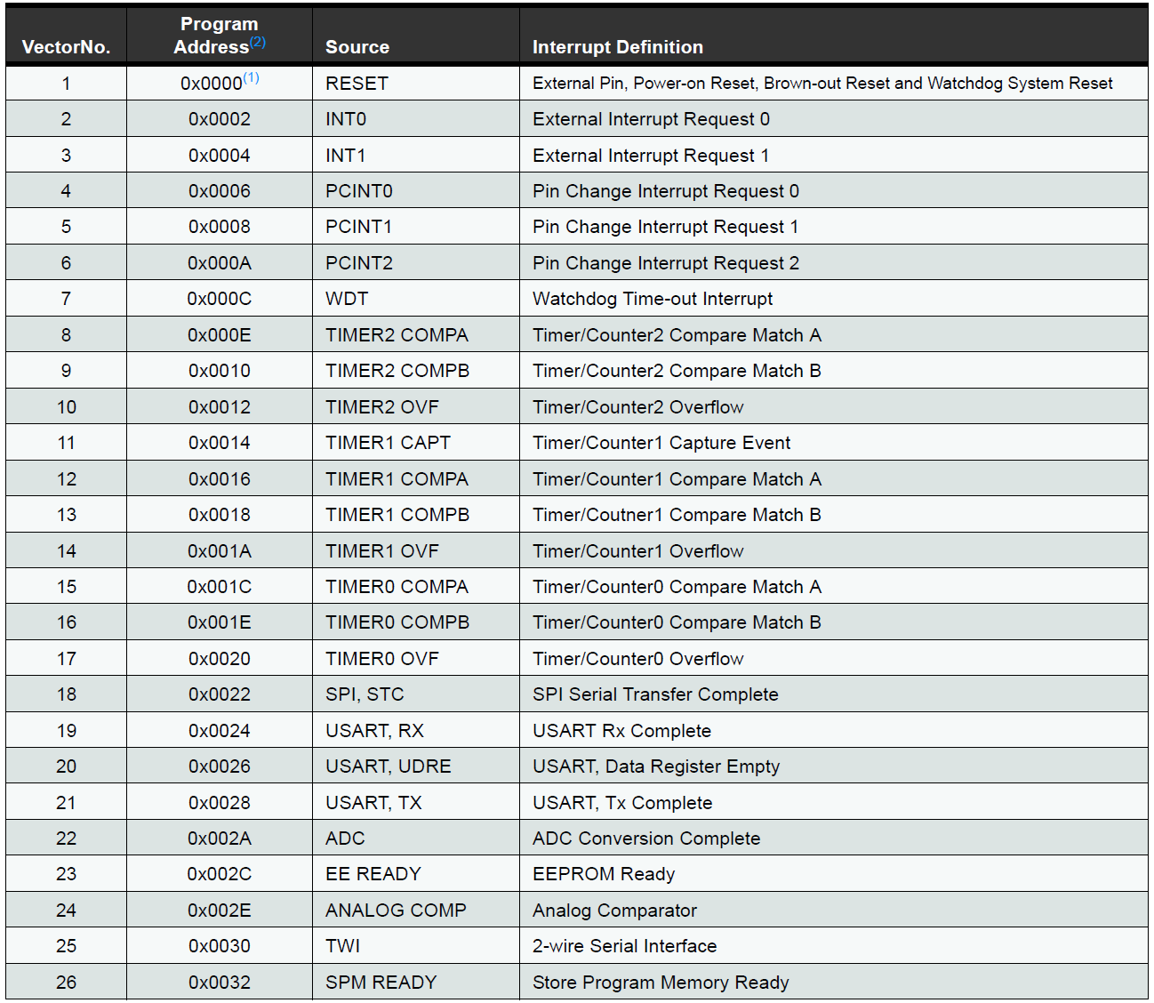
Interrupt Sources of ATmega328
26 x interrupt sources
The lower the address the higher is the priority level.

Slide 50
Interrupt Masking of ATmega328
Interrupt masking
In order to allow interrupt, global, local interrupt mask should be enabled.
Global interrupt mask
SREG의 I-bit : 1(enable), all interrupts are enabled.
Whenever entering ISR, I-bit is automatically set to ‘0’(disable), and set to ‘1’ after return from ISR.
Private interrupt mask
Determines whether each interrupt is enable or not.
To enable an interrupt request, both global & local mask should be set to ‘1’.

Slide 51
External Interrupt of ATmega328
External interrupt
Triggered by INT0, 1 pin or any of PCINT0~23(pin change interrupt).
PCI0 will trigger if any enabled PCINT[7:0] pin toggles.
PCI1 will trigger if any enabled PCINT[14:8] pin toggles.
PCI2 will trigger if any enabled PCINT[23:16] pin toggles.
Interrupt detection
External interrupts can be triggered by a falling/rising edge, low level.
Depends on the setting of External Interrupt Control Register(EICR).
Even if INT, PCINT are configured as output, interrupt will trigger.
Provides a way of generating a software interrupt.

Slide 52
Control Register of External Interrupt
External interrupt
EICRA : external interrupt control register
EIMSK : external interrupt mask register
EIFR : external interrupt flag register
Pin change interrupt (PCI)
PCICR : PCI control register
PCMSK2, 1, 0 : PCI mask register
PCIFR : PCI flag register

Slide 53
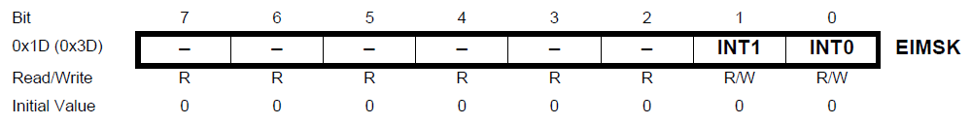
Mask of External Interrupt
EIMSK(External Interrupt Mask Register)
External interrupt mask register
0 (disable), 1 (enable)
When the INTx bit is set (one) and the I-bit in the Status Register (SREG) is set (one), the external pin interrupt is enabled.

Slide 54
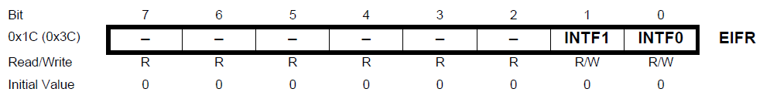
Flag of External Interrupt
EIFR (External Interrupt Flag Register)
When an edge or logic change on the INTx pin triggers an interrupt request, INTFx becomes set (one).
If the I-bit in SREG and the INTx bit in EIMSK are set (one), the MCU will jump to the corresponding Interrupt Vector.
The flag is cleared when the interrupt routine is executed.
Alternatively, the flag can be cleared by writing a logical one to it.
This flag is always cleared when INTx is configured as a level interrupt.

Slide 55
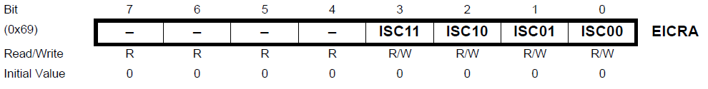
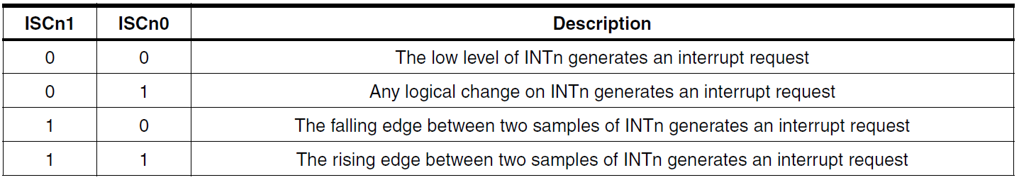
Sense Control of External Interrupt
The sensing way of external interrupted is controlled by ISC(interrupt sense control) field of EICRA.
ISC field : ISC[1:0]

Slide 56
Sense Control of External Interrupt
Minimum pulse width
If edge or toggle interrupt is selected, pulses that last longer than one clock period will generate an interrupt.
If low level interrupt is selected, the low level must be held until the completion of the currently executing instruction to generate an interrupt.

Slide 57
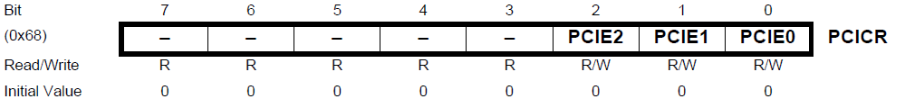
Control of Pin Change Interrupt
PCI Control Register
PCI enable flag (PCIE2,1,0)
PCIE = 1 (enable)
When the PCIEx bit is set (one) and the I-bit in the Status Register (SREG) is set (one), pin change interrupt is enabled.
Any change on any enabled PCINT[23:0] pin will cause an interrupt.
PCIE0 : PCINT[7:0]
PCIE1 : PCINT[15:8]
PCIE2 : PCINT[23:16]

Slide 58
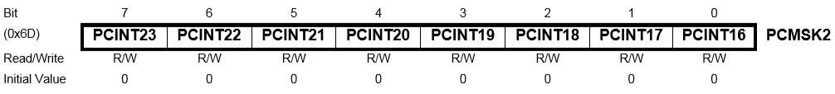
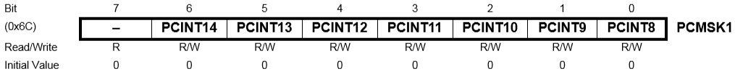

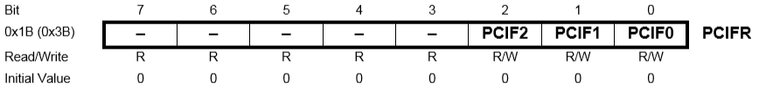
Control of Pin Change Interrupt
PCI mask register
PCI flag register

Slide 59
ISR Programming
ISR for external interrupt (INT0)
#include <io.h>
#include <interrupt.h>
// INT0 interrupt service routine
ISR(SIG_INTERRUPT0) // SIGNAL(SIG_INTERRUPT0)
{
// body
}
int main(void)
{
DDRD = 0xFE; // interrupt source = D port
EIMSK = 0x01; // enable INT-0
sei(); // enable global interrupt
for (;;) ; // main body
}
sei() : global interrupt enable,
cli() : global interrupt disable

Slide 60
Example
#include<avr/io.h>
#include<avr/interrupt.h>
#include<util/delay.h>
unsigned char Time_STOP = 0;
SIGNAL(SIG_INTERRUPT0);
int main(){
unsigned char LED_Data = 0x01;
DDRD = 0xFE; // Port D.0 → Switch (INT0)
DDRE = 0xFF; // Port E → LED
EICRA = 0x0F; // Detect policy of INT0, INT1 → rising edge
EICRB = 0x00; // others → low level
EIMSK = 0x01; // Mask of INT0 → enable
EIFR = 0x01; // Flag of INT0 → clear
sei(); // global interrupt mask -> enable
while(1) {
PORTE = LED_Data;
if(Time_STOP == 0) {
if(LED_Data == 0x80) LED_Data = 0x01;
else LED_Data <<= 1;
}
_delay_ms(100);
}
return 0;
}

Slide 61
Example
ISR(SIG_INTERRUPT0) { // ISR of INT0
cli();
if(Time_STOP == 0)
Time_STOP = 1;
else
Time_STOP = 0;
sei();
}

Slide 62
Arduino ISR
Interrupt pin
Digital pin : 2(INT0), 3(INT1) in Uno
Functions for interrupt handling
Registration of ISR : “attachInterrupt()”
Options of interrupt sensing method
FALLING, RISING, CHANGE, LOW
Mapping digital pin to interrupt number : “digitalPinToInterrupt()”
ISR removal : “detachInterrupt()”
Interrupt enabling/disabling : “interrupts()/nointerrupts()”
ISR : no parameters, no return
Use global variable for data exchange.
attachInterrupt(interrupt, ISR, mode);
* interrupt : interrupt 번호.
* ISR : interrupt service routine,
* mode : interrupt sensing method
attachInterrupt(digitalPinToInterrupt(pin), ISR, mode);

Slide 63
Arduino ISR
Example
int pin = 13; volatile int state = LOW; void setup() { pinMode(pin, OUTPUT); attachInterrupt(digitalPinToInterrupt(pin), blink, CHANGE); } void loop() { digitalWrite(pin, state); } void blink() { state = !state; }

Slide 64
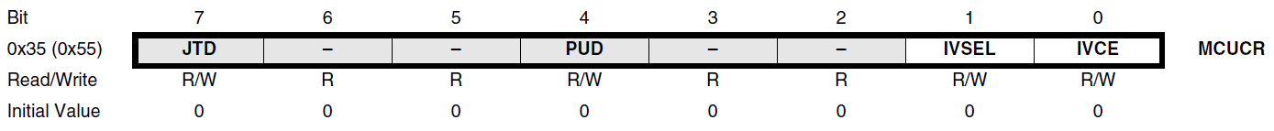
Changing the Location of IVT
Moving IVT to boot section using IVSEL, IVCE.
IVSEL(interrupt vector select) bit of MCUCR
When the IVSEL bit is cleared (zero), the Interrupt Vectors are placed at the start of the Flash memory.
When this bit is set (one), the Interrupt Vectors are moved to the beginning of the Boot Loader section of the Flash.
The actual address of the start of the Boot Flash Section is determined by the BOOTSZ Fuses.
IVCE(interrupt vector change enable) bit of MCUCR
To avoid unintentional changes of Interrupt Vector tables, a special write procedure must be followed to change the IVSEL bit:
1. Write the Interrupt Vector Change Enable (IVCE) bit to one.
2. Within four cycles, write the desired value to IVSEL while writing a zero to IVCE.
void Move_interrupts(void)
{
/* Enable change of Interrupt Vectors */
MCUCR = (1<<IVCE);
/* Move interrupts to Boot Flash section */
MCUCR = (1<<IVSEL);
}

Slide 65
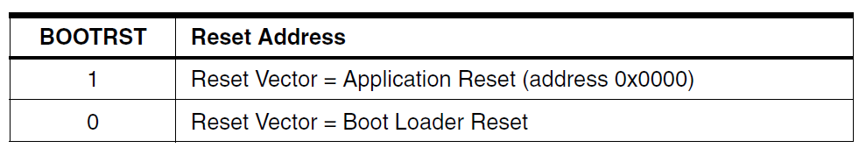
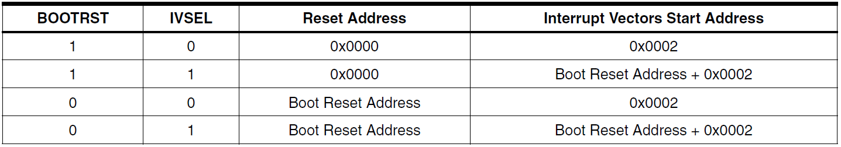
Changing the Location of Reset Vector
Changing reset vector using BOOTRST fuse bit.
Reset Vector can also be moved to the start of the Boot Flash section by programming the BOOTRST Fuse.
Fuse bit : 1 (unprogrammed), 0 (programmed)

Slide 66
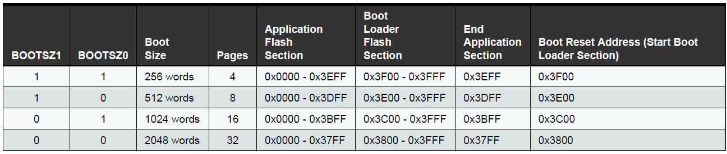
Changing the Size of Boot Section.
The size of boot section is configured by BOOTSZ[1:0] fuse bits.
The Actual address of the start of the Boot Flash Section is determined by the BOOTSZ Fuses.

Slide 67
Read-While-Write Self-Programming
Boot Loader Support feature of ATmega328 provides a real Read-While-Write Self-Programming mechanism for downloading and uploading program code by the MCU itself.
Allows flexible application software updates controlled by the MCU using a Flash-resident Boot Loader program.
Boot Loader program can use any available data interface and associated protocol to read code and write (program) that code into the Flash memory, or read the code from the program memory.
The program code within the Boot Loader section has the capability to write into the entire Flash, including the Boot Loader memory.
The Boot Loader can thus even modify itself, and it can also erase itself from the code if the feature is not needed anymore.

Slide 68
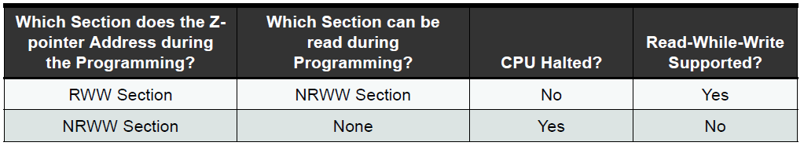
Read-While-Write Self-Programming
Additionally, flash memory is divided into two fixed section.
Read-While-Write (RWW) section
When erasing or writing a page located inside the RWW section, the NRWW section can be read during the operation.
If a Boot Loader software update is programming a page inside the RWW section, it is possible to read code only from NRWW section of the Flash.
No Read-While-Write (NRWW) section :
When erasing or writing a page located inside the NRWW section, the CPU is halted during the entire operation.
The code located in the NRWW section can be read when the Boot Loader software is updating a page in the RWW section.
When the Boot Loader code updates the NRWW section, the CPU is halted during the entire Page Erase or Page Write operation.

Slide 69
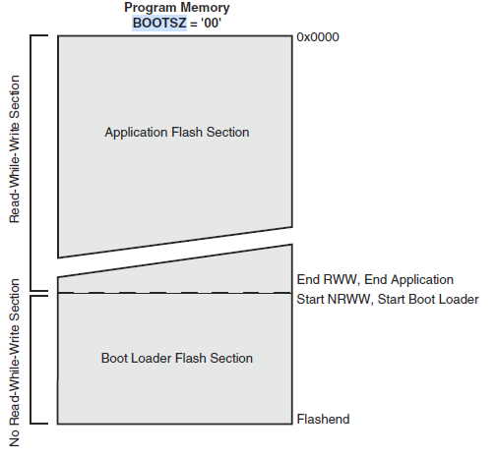
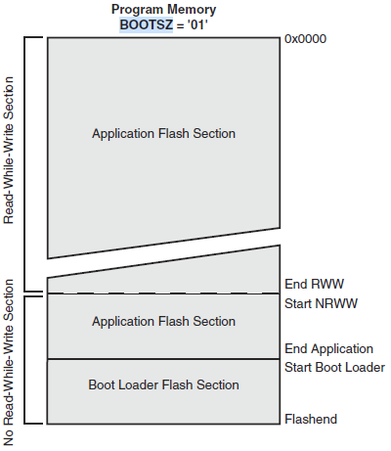
Read-While-Write Self-Programming
Configuration of RWW/NRWW according to BOOTSZ[1:0] fuses
Fuse bit : 1 (unprogrammed), 0 (programmed)

Slide 70
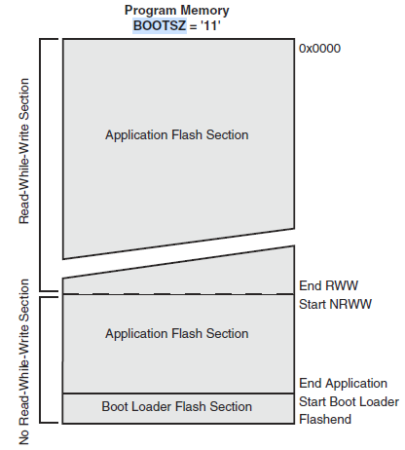
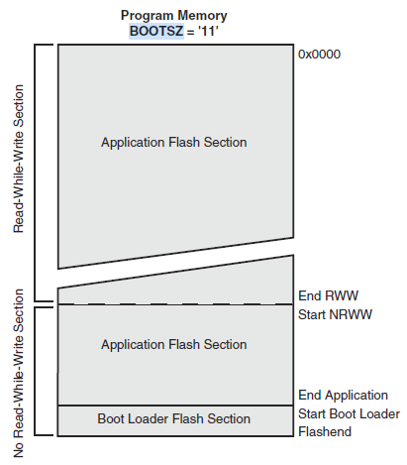
Read-While-Write Self-Programming
Configuration of RWW/NRWW according to BOOTSZ[1:0] fuses
Fuse bit : 1 (unprogrammed), 0 (programmed)

Slide 71
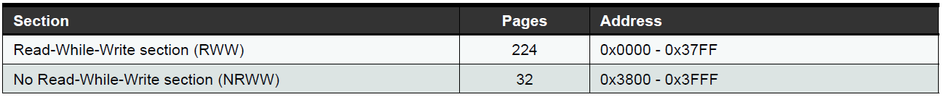
Read-While-Write Self-Programming
RWW/NRWW of ATmega328

Slide 72
Timer

Slide 73
Overview
Timer
General purpose H/W counter
Time measurement
Counting the frequency of event occurrence.
Waveform generation (PWM)
control the power of supplying to external device.
Basic structure of timer in AVR core
TOV
OCR
PWM : Pulse Width Modulation
TCNT : Timer/Counter
OCR : Output Compare match Register
ICR : Input Capture Register
TOV : Timer OVerflow
OCF : Output Compare Flag
ICF : Input Capture Flag
prescaler
TCNT
=
Waveform Generator
Waveform (PWM)
ICF
CLK_I/O/Tn/TOSC
OCF
ICR

Slide 74
Timer of ATmega328
3 Timers
2 x 8-bit timer : Timer-0, 2
1 x 16-bit timer : Timer-1
Operation mode
Normal mode
CTC(Clear Timer on Compare Match) mode
Fast PWM mode
Phase correct PWM mode
Phase and Frequency Correct PWM mode
16-bit timer only
Timer interrupt
TOV (timer overflow)
When the value of timer is changed from 0xFF to 0x00.
OCF (output compare match flag)
When the value of timer is same as that of OCR.
ICF (input capture flag)
When the value of timer is captured into ICR.

Slide 75
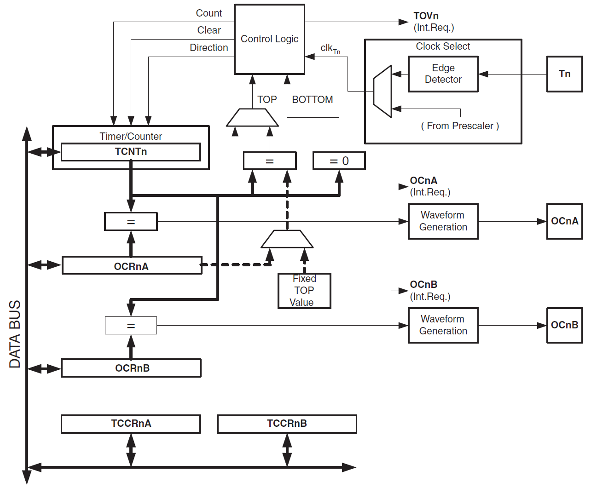
Block Diagram of Timer-0
8-bit timer

Slide 76
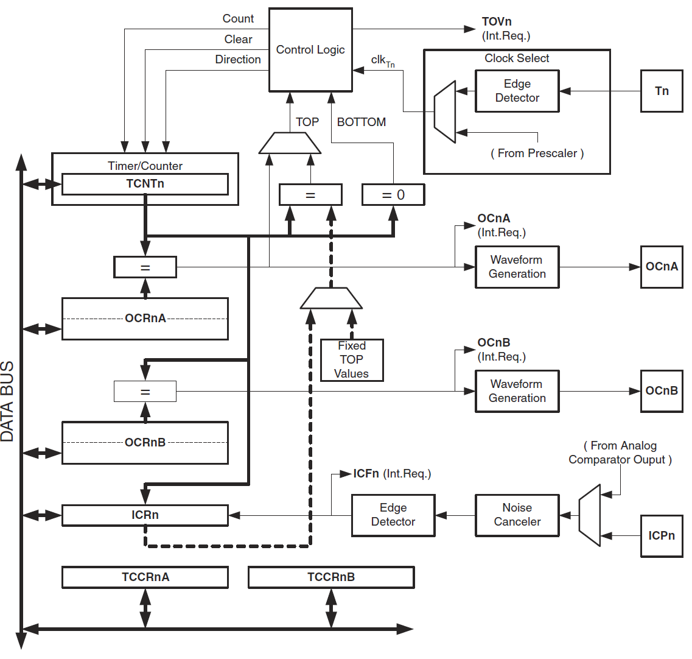
Block Diagram of Timer-1
16-bit timer

Slide 77
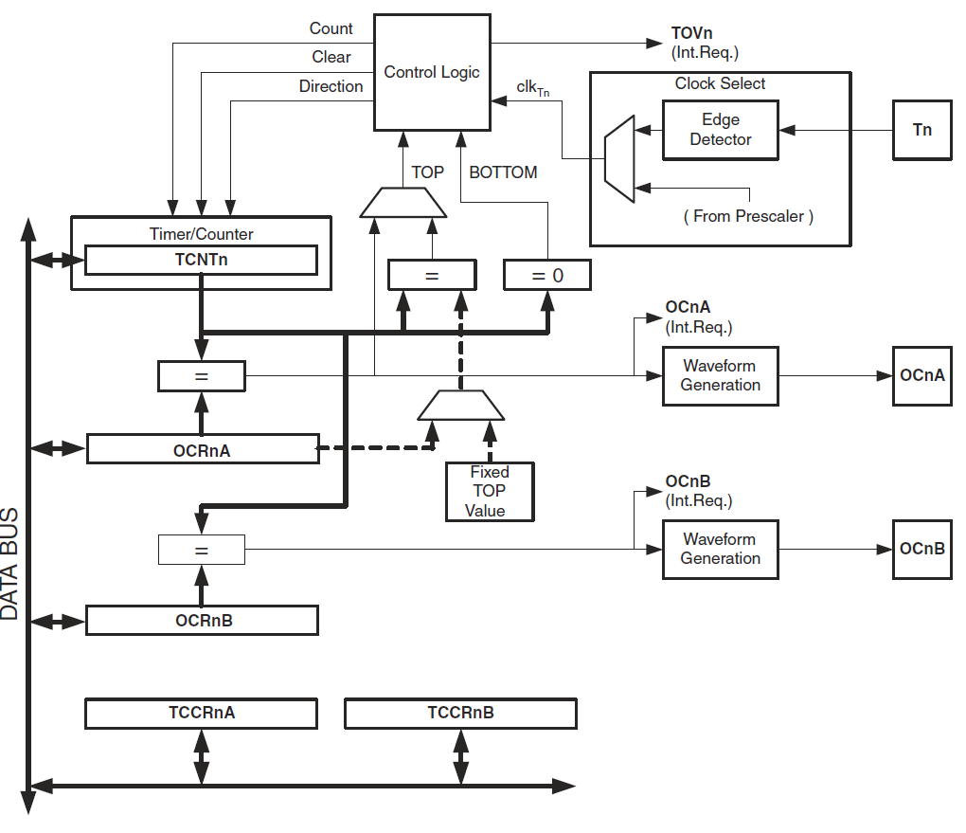
Block Diagram of Timer-2

Slide 78
Operation Mode
Operation mode
According to operation mode, counting sequence of counter is different..
Normal mode
CTC(Clear Timer on Compare Match) mode
Fast PWM mode
Phase correct PWM mode
Phase and Frequency Correct PWM mode
16-bit timer only
Configuration of operation mode
WGM and COM field of TCCR
WGM : determine counting sequence.
COM : control OC output on compare matched.
PWM mode : inverted or non-inverted
Non-PWM mode : clear, set, toggle
PWM : Pulse Width Modulation
CTC : Clear Timer on Compare match
WGM : Waveform Generation Mode
COM : Compare Output Mode
TCCR : Timer/Counter Control Register
OC : Output Compare

Slide 79
Normal Mode
Single-slope operation
Always up counting
BOTTOM(0x00) → MAX (0xFF)
No initialization
TOV is set when TCNT becomes 0x00 from 0xFF.
Preset of TCNT is possible.

Slide 80
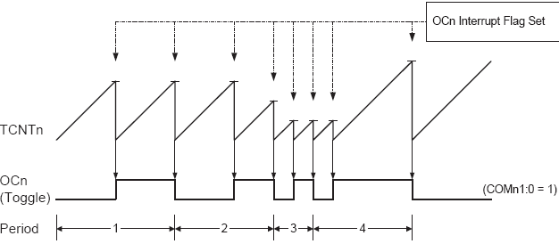
CTC Mode
CTC (Clear Timer on Compare match) mode
Single-slope operation
BOTTOM → TOP (OCR0A)
Whenever TCNT equals to OCR
Timer set to ‘0’, OCF interrupt is generated, OC pin toggle.
F(OC) = f_CLK_I/O / (2*N*(1+OCR),
N (prescale factor)=1, 8, 64, 256, 1024

Slide 81
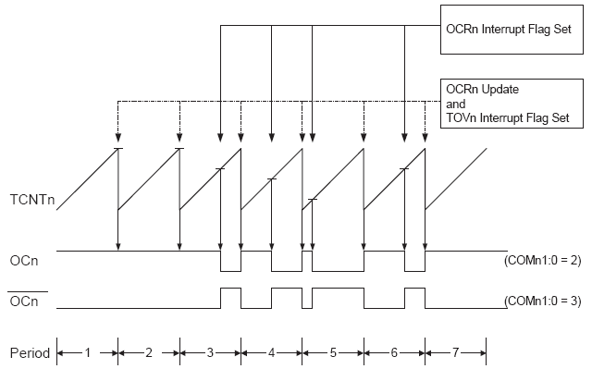
Fast PWM Mode
Single-slope operation
BOTTOM → TOP : 0xFF(WGM=3), OCR0A(WGM=7)
Whenever TCNT equals to TOP
TOV or OCF is generated.
Whenever TCNT equals to OCR
Non-inverting PWM mode : OCF is generated, OC becomes ‘0’, and if BOTTOM, change to ‘1’.
Inverting PWM mode : reverse of non-inverting mode.
F(OC) = f_CLK_I/O / (N*256), N=1, 8, 64, 256, 1024

Slide 82

Phase Correct PWM Mode
Dual-slope operation
BOTTOM → TOP → BOTTOM (up/down counting)
TOP : 0xFF (WGM[2:0]=1), OCR0A (WGM[2:0]=5)
TCNT=OCR
OCF is generated.
In non-inverting mode & up-counting, OC becomes to ‘0’. If down-counting, OC becomes to ‘1’.
TCNT=BOTTOM : TOV is generated.
TCNT=TOP : OCR value is updated.
F(OC) = f_CLK_I/O / (N*510), N=1, 8, 64, 256, 1024

Slide 83

Phase & Frequency Correct PWM Mode
Dual-slope operation
BOTTOM → TOP → BOTTOM
TOP : ICR (WGM=8), OCR (WGM=9)
TCNT=OCR
OCF is generated.
If non-inverting mode & up-counting, OC = ‘0’, and if down-counting, OC=‘1’.
TCNT=BOTTOM
TOV is generated.
OCR/TOP value is updated.
TCNT=TOP
If TOP is configured by
OCR, OCF is generated.
ICR, ICF is generated.
F(OC) = f(CLKI/O) / (2*N*TOP)

Slide 84
Timer Registers
TCNT : Timer/Counter Register
Store counter value.
TCCR : Timer/Counter Control Register
Control the operation of timer
TIMSK : Timer/Counter Interrupt Mask Register
Enable/disable interrupt of timer
TIFR : Timer/Counter Interrupt Flag Register
Interrupt flags
OCR : Output Compare Register
The value compared with TCNT
ICR : Input Capture Register
The captured value of TCNT
ASSR (Asynchronous Status Register)
Control of external clock
GTCCR (General Timer/Counter Control Register)
Control of prescaler reset.

Slide 85


TCNT
Timer/counter register itself
Stores counter’s present value.
TCNT0,2 : 8-bit
TCNT1 : 16-bit, TCNTnH + TCNTnL 연결사용
Timer-0
Timer-2

Slide 86

TCNT
Timer-1

Slide 87
TCCR
Timer control register
Control of timer’s clock, operation mode, output of OC pin, input of ICP.
CS (Clock Select) field : select clock source.
WGM (Waveform Generation Mode) field : select operation mode.
COM (Compare Output Mode) field : control the output of OC pin.
FOC (force output compare) field : control the output of OC pin.
ICNC (input capture noise canceler) flag : control the input of ICP pin.
ICES (input capture edge select) flag : control the input of ICP.
Timer-0,2 : TCCRnA, TCCRnB, n=0,2
Timer-1 : TCCRnA, TCCRnB, TCCRnC, n=1

Slide 88


TCCR
Timer-0,2
Timer-1

Slide 89

TCCR
WGM (waveform generation mode) field
Timer-0,2

Slide 90

TCCR
WGM (waveform generation mode) field
Timer-1

Slide 91


TCCR
COM (compare output mode) field
Timer-0, 2

Slide 92

TCCR
COM (compare output mode) field
Timer-0,2

Slide 93


TCCR
COM (compare output mode) field
Timer-1

Slide 94

TCCR
COM (compare output mode) field
Timer-1

Slide 95


TCCR
CS (clock select) field
Select clock source
Timer-0
Timer-2

Slide 96

TCCR
CS (clock select) field
Select clock source
Timer-1

Slide 97
TCCR
FOC (Force Output Compare) field
Only applied to non-PWM modes.
FOC = 1
The result of compare match is transferred to waveform generator, finally output to OC pin.
The waveform of OC pin depends on COM field.
No interrupt, no clear on timer.
Timer-0,2 : FOCnA, FOCnB, n=0,2
Timer-1 : FOCnA, FOCnB, FOCnC, n=1

Slide 98

ICNC/ICES
ICNC (input capture noise canceler) : Timer-1,3
1 : canceler enable
Check 4 sequences of pulses on ICP pin.
ICES (input capture edge select) : Timer-1,3
0 : falling edge
1 : rising edge

Slide 99

TIMSK
TIMSK (Timer Interrupt Mask)
Interrupt masks for TOV, OCF, ICF (1=enable)
Timer-0,2
Timer-1

Slide 100
TIFR
Timer Interrupt Flag Register
Store interrupt flags(TOV, OCF, ICF) of timer.
Cleared if ‘1’ is written.
Automatically cleared when ISR is entered.
Timer-0,2
Timer-1

Slide 101


OCR
OCR (output compare register)
Store target value for comparing with timer.
Timer-0,2 : OCRnA, OCRnB, n=0,2
Timer-1 : OCRnA, OCRnB, OCRnC, n=1,3,4,5
OCRnxH + OCRnxL are connected to make 16-bit, x=A,B

Slide 102
ICR
ICR (input capture register)
Store the captured value of timer
ICRnH + ICRnL are connected to make 16-bit register.
Only for Timer-1.
How to trigger the capture.
Triggered by ICPx pin.
Triggered by the output of analog comparator.

Slide 103
ASSR
ASSR (asynchronous status register)
Only for Timer-2 when external clock is used.
EXCLK : enable the external clock.
If EXCLK=1 : use TOSC1 pin as clock source.
AS2 (asynchronous timer)
AS2=0 : use internal clock..
AS2=1 : generate timer clock by connecting TOSC1,2 pin & external crystal.
When RTC is clocked by external 32.768KHz crystal.
TCN2UB (timer counter 2 update busy)
1 if TCNT2 is used in async. mode.
TCR2AUB/TCR2BUB (timer control register 2 update busy)
1 if TCCR2 is used in async. mode.
OCR2AUB/OCR2BUB (output compare register 2 update busy)
1 if OCR2 is used in async. mode.

Slide 104

GTCCR
General Timer/Counter Control Register
TSM : Timer/Counter Synchronization Mode
TSM=1 : Sync. mode. Timer halt.
TSM=0 : Timer is operated, PSRASY, PSRSYNC are automatically cleared.
PSRSYNC : prescaler reset for synchronous timer/counter.
PSRSYNC=1 : prescaler reset
For timer-0,1
PSRASY : prescaler reset timer/counter2
PSRASY=1, prescaler reset
For timer-2

Slide 105
ADC

Slide 106
Overview of ADC
ADC(analog-to-digital conversion)
Convert the analog signal representing physical quantities to digital signal.
Basic procedure of AD conversion
Sample & Hold
Sample the continuous analog signal and hold its signal level for a period.
sample. & hold time
Quantization
Convert the sampled signal to digital value.
Resolution

Slide 107



Overview of ADC
Conventional methods of ADC
direct-conversion (flash)
Successive-approximation
Ramp-compare (stair-case)

Slide 108
ATmega328 ADC
Feature of ADC
10-bit resolution successive approximation ADC
Conversion time : 13~260 us
Max. sampling frequency : 15 kSPS @ max. resolution.
Input channels
Voltage level : 0 ~ VCC
6 x multiplexed single-ended channels
2 additional channels only for TGFP, GFN/MLF package.
Temperature sensor input channel
Accuracy
0.5 LSB integral non-linearity
+/- 2 LSB absolute accuracy
Additional functions
Left adjustment for ADC result readout
Selectable 1.1V ADC reference voltage
Free running & single conversion
Interrupt on conversion complete
Sleep mode noise canceller

Slide 109

ADC Block Diagram

Slide 110

Conversion Timing
ADC initialization : 25 ADC clock cycles
Normal conversion : 13 ADC clock cycles
Sample-and-Hold time
The first conversion : 13.5 ADC clock cycles
After 1st conversion : 1.5 ADC clock cycles

Slide 111


Single Conversion

Slide 112

Free-running Conversion
Continuous conversion

Slide 113

Precision of ADC
n-bit single-ended conversion
GND : 0
V(ref) : 2n – 1, n=10
Quantization error
The difference between the analog signal and the closest available digital value at each sampling instant from the A/D converter.
Absolute accuracy
The maximum difference between the actual value and the conversed value.
Offset error, gain error, differential error, non-linearity error.
The conversion result of ADC is stored into ADC Result Register (ADCL, ADCH).
Single-ended signal conversion
0~1023(0x3FF)

Slide 114


Offset/Gain Error
Offset error
The deviation of the first transition (0x000 to 0x001) compared to the ideal transition (at 0.5 LSB).
Ideal value: 0 LSB.
Gain error
The deviation of the last transition (0x3FE to 0x3FF) compared to the ideal transition (at 1.5 LSB below maximum).
Ideal value: 0 LSB

Slide 115


INL/DNL Error
Integral Non-linearity (INL)
The maximum deviation of an actual transition compared to an ideal transition for any code.
Ideal value: 0 LSB.
Differential Non-linearity (DNL)
The maximum deviation of the actual code width (the interval between two adjacent transitions) from the ideal code width (1 LSB).
Ideal value: 0 LSB.

Slide 116
ADC Registers
ADMUX (ADC Multiplexer Selection Register)
ADCSRA/B (ADC Control and Status Register A/B)
ADCL/ADCH (ADC Data Register Low/High)
DIDR0/2 (Digital Input Disable Register 0/2)

Slide 117


ADMUX
ADC Multiplexer Selection Register (ADMUX)
REFS1:0 (Reference Selection Bits)
ADLAR (ADC Left Adjust Result)
If ‘1’, the value of conversion result is left-adjusted. (MSB side).

Slide 118

ADMUX
MUX3:0 (Analog Channel Selection Bits)
Select the analog input.

Slide 119

ADCSRA
ADC Control and Status Register – A
ADEN (ADC Enable)
1 : ADC circuit enabled
ADSC (ADC Start Conversion)
1 : conversion start. After finish, set to ‘0’ automatically.
ADATE (ADC Auto Trigger Enable)
1 : Start at the rising edge of trigger signal.
ADIF (ADC Interrupt Flag)
1 : After conversion is completed, set to ‘1’. For clear, write ‘1’ to it.
ADIE (ADC Interrupt Enable)
1 : interrupt enabled.

Slide 120


ADCSRA
ADPS2:0 (ADC Pre-scaler Select)
Scaling factor of ADC clock

Slide 121


ADCSRB
ADC Control and Status Register – B
ADTS[2:0] (ADC Auto Trigger Source)

Slide 122


DIDR
DIDR (Digital Input Disable Register)
ADC[15:0] pin의 digital input buffer disable
It’s possible to save power consumption if DIDR set to ‘1’ only when ADC pin is used for ADC.

Slide 123


ADCL & ADCH
ADC Data Register (ADCL, ADCH)
Store the conversion result.
Only after reading ADCL, ADCH can be read.

Slide 124
Procedure of ADC use
Select the analog input channel.
Select the reference voltage & adjustment of the result.
Select conversion mode(free-running, single)
Determine the scaling factor of ADC clock.
Enable ADC.
Start ADC : Set ADSC flag of ADCSRA register to ‘1’.
After the conversion is completed, ADC complete interrupt is generated.
- In ISR, the conversion result stored in ADCL, ADCH can be accessed.

Slide 125
USART

Slide 126
Overview of Serial Communication
Serial communication
Bit-serial communication
After converting a byte-aligned or word-aligned data into a series of bits, send each bit one-by-one serially.
Depending on whether clock is required or not, synchronous/asynchronous is categorized.
If clock is used to send data, it’s sync..
Small cost, good to long distance compare with parallel communication.
Serial Protocol
USART(Universal Synchronous and Asynchronous serial Receiver and Transmitter)
UART(Universal Asynchronous serial Receiver and Transmitter)
Usage
Simple & low cost data transfer
Status monitoring & control of various types of electrical & electronic devices.

Slide 127
Type of Serial Communication
Type of data transfer
Bit-serial
Bit-wise data transfer.
Save the transmission line cost.
Slow transmission speed.
Bit-parallel (byte-serial)
Data transfer in bytes.
High transmission line cost
Fast transmission speed
Term-1
Term-2
Term-1
Term-2
Bit-serial
Bit-parallel

Slide 128



Type of Serial Communication
Type of transmission path
Simplex : only one way
Half-duplex : both way, but one way at a time.
Full-duplex : both way at the same time
Simplex
Half-duplex
Full-duplex

Slide 129
Type of Serial Communication
Type of Signaling
Balanced : 2-wire(+, -) transmission.
Strong to noise (high noise immunity).
Good for long distance transmission.
High cost
Unbalanced : 1-wire(+) transmission.
Weak to noise,
Short distance transmission.
Low cost
signal
Term-1
Term-2
unbalanced
ground
ground
signal(+)
Term-1
signal(-)
Term-2
balanced
ground
ground

Slide 130
Type of Serial Communication
Transmission timing
Synchronous
Use a separate clock line to synchronize the data transmission.
High speed transmission with high cost.
Asynchronous
Self-timed transmission by data lines.
Sampling & detecting using internal timing generator.
Low speed transmission with low cost.
Term-1
Data
Term-2
Clock
Synchronous
Term-1
Data (self-timing)
Term-2
Asynchronous
Timing generator

Slide 131

Type of Serial Communication
Flow control
The way of handshaking between transmitter & receiver.
Hardware flow control
Dedicated control lines for flow control : RTS/CTS, DTR/DSR
RTS (request to send)/CTS(clear to send) : The DTE asserts RTS to indicate a desire to transmit to the DCE, and in response the DCE asserts CTS to grant permission.
DTR (data terminal ready)/DSR(data set ready) : to indicate that the terminal is ready for communications and the modem may initiate a communications channel. DSR is set when DCE is ready to receive and send data.

Slide 132

Type of Serial Communication
Software flow control
Flow control by software
Control the flow control using control characters(XON/XOFF code).
Xmodem

Slide 133

USART
USART(Universal Sync/Async Receiver/Transmitter)
Typical serial communication protocol
Serial port, COM port, RS-232C.
Frame format of USART packet
Start bit : Indicate the transmission is started. Logical low.
Stop bit : Indicates the transmission is finished. Logical high.
Data bit : data bit
Parity-bit : bit for parity checking

Slide 134



USART
Physical interface(line driver/receiver) is required for long-distance transmission.
Standard physical interface
RS-232C (EIA), V.24 (CCITT), ISO 2110 (ISO)
RS-423, RS-422, RS-485
TTL level
Line driver/receiver
Tx
Rx
Rx
Tx
GND
GND
http://mirine35.egloos.com/viewer/5057212

Slide 135

USART
Comparison of physical interfaces
Single-ended : unbalanced. 2-wire(Tx, Rx). common GND.
Differential : balanced. 4-wire(Tx+, Tx-, Rx+, Rx-).
http://arindamcctvaccesscontrol.blogspot.com/2015/03/rs422-rs485-comparison-with-rs232.html

Slide 136







USART
Serial connectors and signal connections
인용 : http://mirine35.egloos.com/viewer/5057212

Slide 137
USART
Serial ports of Windows PC
COM1,2,3,4
Virual COM : simulation of serial port using USB port
Serial monitor program
Monitoring the data to transmit/receive to/from serial port.
Data transmit : keyboard
Data received : display on screen.
hyperterminal

Slide 138
Serial Port of ATmega328
USART
1 ports
2-wire Sync/Async
SPI
1 port
3-wire Sync
TWI (Two-wire Serial Interface)
1 port
2-wire Sync
Same as Philips I2C

Slide 139
ATmega2560 USART
1 x USART port
USART0
Features
Full Duplex Operation (Independent Serial Receive and Transmit Registers)
Asynchronous or Synchronous Operation (Master or Slave Clocked Synchronous Operation)
Supports Serial Frames with 5, 6, 7, 8, or 9 Data Bits and 1 or 2 Stop Bits
Odd or Even Parity Generation and Parity Check Supported by Hardware
Data OverRun/Framing Error Detection
Noise Filtering Includes False Start Bit Detection and Digital Low Pass Filter
Three Separate Interrupts on TX Complete, TX Data Register Empty and RX Complete
Multi-processor Communication Mode
Double Speed Asynchronous Communication Mode

Slide 140

Block Diagram of USART

Slide 141

Clock Generator
Provides clock to transmitter and receiver
Clock source : internal clock or external clock
baud rate generator
Consists of UBRR (USART Baud Rate Register) & down counter.
Double / Normal ?
Sync / Async ?
Internal / External ?
Rising / Falling ?

Slide 142
Clock Generator
The USART supports four modes of clock operation
Normal asynchronous, Double Speed asynchronous, Master synchronous and Slave synchronous mode.
The UMSELn bit in USART Control and Status Register C (UCSRnC) selects between asynchronous and synchronous operation.
Double Speed (asynchronous mode only) is controlled by the U2Xn found in the UCSRnA Register.
When using synchronous mode (UMSELn = 1), the Data Direction Register for the XCKn pin (DDR_XCKn) controls whether the clock source is internal (Master mode) or external (Slave mode).
The XCKn pin is only active when using synchronous mode.

Slide 143

Internal Clock Source
Reference clock for baud rate generator is generated by internal system clock.
Internal clock generation is used for the asynchronous and the synchronous master modes of operation.
The USART Baud Rate Register (UBRRn) and the down-counter connected to it function as a programmable prescaler or baud rate generator.
The down-counter, running at system clock (fosc), is loaded with the UBRRn value each time the counter has counted down to zero or when the UBRRnL Register is written.
Frequency of baud rate generator’s clock output = fosc/(UBRR+1)

Slide 144

Baud Rate Setting Table
When internal clock source is used, UBRR should be properly set according setting table.

Slide 145

External Clock Source
User the external clock provided by XCK pin as the reference clock
Use for synchronous slave mode.
Clock detection by synchronization register & edge detector with 2 CPU clock delay.
Max. frequency of external clock : < (fosc/4)
Synchronous Mode XCKn Timing
Data changed

Slide 146

Frame Format
1 start bit
5,6,7,8,9 data bits
No, even, odd parity bits for error checking
1 or 2 stop bits

Slide 147
USART Registers
UDR (USART I/O Data Register)
Store transmit/receive data.
UCSRA/B/C (USART Control and Status Register A/B/C)
Store control & status information.
UBRR (USART Baud Rate Register)
Consist of UBRRH & UBRRL.
Use for configuration of Baud rate.

Slide 148

UDR
USARTn I/O Data Register (UDRn)
The USART Transmit Data Buffer Register and USART Receive Data Buffer Registers share the same I/O address referred to as USART Data Register or UDRn.
The receive buffer consists of a two level FIFO.

Slide 149

UCSRA
USART Control and Status Register A (UCSRnA)
RXCn : USART Receive Complete
TXCn : USART Transmit Complete
UDREn : USART Data Register Empty
FEn : Frame Error
DORn : Data Overrun
UPEn : Parity Error
U2Xn : Double USART Transmission Speed
MPCMn : Multi-processor Communication Mode

Slide 150

UCSRB
USART Control and Status Register B (UCSRnB)
RXCIEn : RX Complete Interrupt Enable
TXCIEn : TX Complete Interrupt Enable
UDRIEn : USART Data Register Empty Interrupt Enable
RXENn : Receiver Enable
TXENn : Transmitter Enable
UCSZn2 : Character Size
RXB8n : Receive Data Bit 8
TXB8n : Transmit Data Bit 8

Slide 151

UCSRC
USART Control and Status Register C (UCSRnC)
UMSELn : USART Mode Select, 0=async, 1=sync
UPMn1:0 : Parity Mode, 00=disabled, 10=even, 11=odd
USBSn : Stop Bit Select, 0=1-bit, 1=2-bit
UCSZn : Character Size, 000=5-bit, 001=6-bit, 010=7-bit, 011=8-bit, 111=9-bit
UCPOLn : Clock Polarity, 0=rising, 1=falling

Slide 152
UCSRC
USART Control and Status Register C (UCSRnC)
UMSELn : USART Mode Select, 0=async, 1=sync
UPMn1:0 : Parity Mode, 00=disabled, 10=even, 11=odd
USBSn : Stop Bit Select, 0=1-bit, 1=2-bit
UCSZn : Character Size, 000=5-bit, 001=6-bit, 010=7-bit, 011=8-bit, 111=9-bit
UCPOLn : Clock Polarity, 0=rising, 1=falling

Slide 153





UBRR

Slide 154
Procedure of USART Initialization
Set the baud rate using UBRR.
Select frame format using UCSRC.
Enable transmitter/receiver UCSRB.
Set global interrupt mask & USART interrupt mask.

Slide 155
Procedure of Data Transmitting/Receiving
Data transmission
Activate the transmitter by setting TXEN(transmit enable) flag of TUCSRB register to ‘1’.
If data is written to UDR, the transmission starts.
In case of 9-bit data transmission mode, TXB8 bit of UCSRB register should be written before transmission starts.
After the transmission is completed, UDRE(data register empty) flag becomes ‘1’.
Data Receiving
Ready to receive if the RXEN(Receive Enable) flag of USRB register set to ‘1’.
If valid start bit is detected, data receiving is started, and stop if stop bit is detected.
After receiving is ended, RX flag becomes to ’1’.
In case of 9-bit data reception mode, RXB8 bit of UCSRB register should be read before UDR is accessed.

Slide 156


Data Sample Timing
Data sampling speed
Normal mode : 16 * baud rate
Double speed mode : 8 * baud rate
Decision of value
By majority voting
If more than 2 among 3 samples have same value, that value is the value of sample.

Slide 157

Data Sample Timing
If high-to-low transition occurs before stop-bit finished, it becomes a start bit.
In normal mode, this transition is thought as start bit.
In double speed mode, this point as start bit
Early start bit detection
Ending point of stop bit

Slide 158
Multi-processor Communication Mode
Multiple CPU can connect to each other through one serial bus.
The type of data frame is categorized into pure data frame & address frame.
Address frame contains address information to identify target transceiver.
Setting the Multi-processor Communication mode (MPCM) bit in UCSRnA enables a filtering function of incoming frames received by the USART Receiver.
Frames that do not contain address information will be ignored and not put into the receive buffer.
Frame type bit
Identify whether the current frame is data frame or address frame.
‘0’ (data frame), ‘1’ (address frame)
When the size of data is 5~8 bits, the first stop bit is frame type bit.
For 9-bit data, RXB8(9th bit) is frame type bit

Slide 159
Multi-processor Communication Mode
Communication procedure
All Slave MCUs are in Multi-processor Communication mode (MPCMn in UCSRnA is set).
The Master MCU sends an address frame
All slaves receive and read this frame. In the Slave MCUs, the RXCn Flag in UCSRnA will be set as normal.
Each Slave MCU reads the UDRn Register and determines if it has been selected. If so, it clears the MPCMn bit in UCSRnA, otherwise it waits for the next address byte and keeps the MPCMn setting.
The addressed MCU will receive all data frames until a new address frame is received. The other Slave MCUs, which still have the MPCMn bit set, will ignore the data frames.
When the last data frame is received by the addressed MCU, the addressed MCU sets the MPCMn bit and waits for a new address frame from master. The process then repeats from 2.

Slide 160

USART Circuit Example

Slide 161
USART Source Code Example
#include<avr/io.h>
void putch(unsigned char data) {
while((UCSR0A & 0x20) == 0); // wait till UDRE0 = 1
UDR0 = data;
UCSR0A |= 0x20; // clear UDRE0
}
int main(){
unsigned char text[] = “hello”;
unsigned char i=0;
DDRE = 0xfe;
UCSR0A = 0x00; // MPCM = 0
UCSR0B = 0x18; // TXEN, RXEN = enable
UCSR0C = 0x06; // Async, No parity, 1 Stop, 8 data
UBRR0H = 0x00;
UBRR0L = 0x03; // 115200 bps @ 7.3728M
while(text[i] != ‘\0’) putch(text[i++]);
return 0;
}

Slide 162
Q & A

